Slide 1
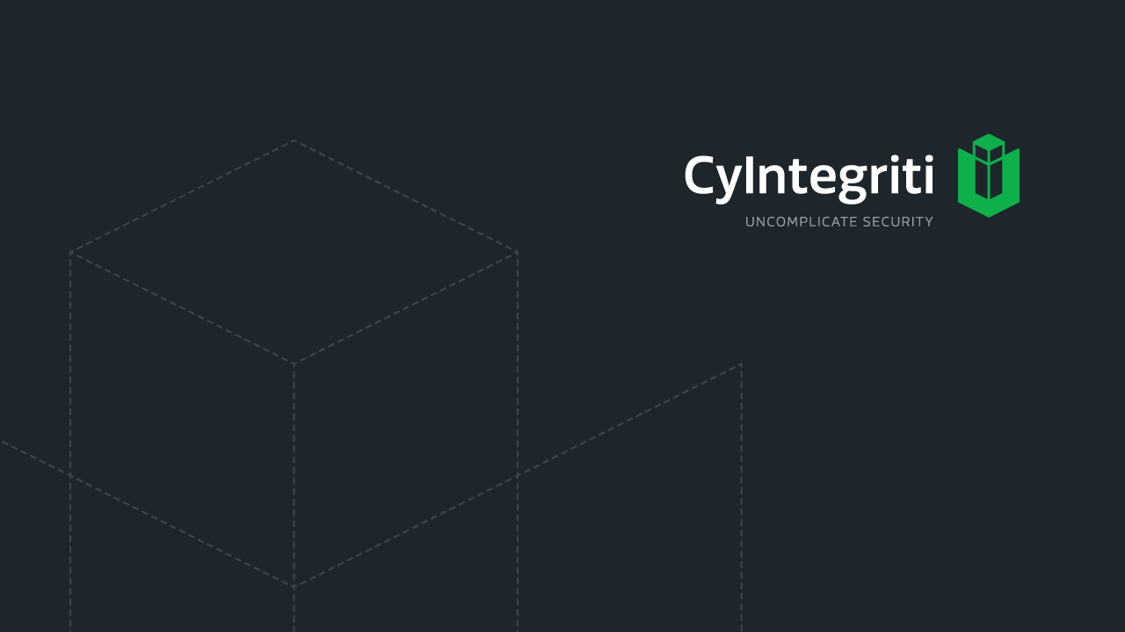
Communications and Network Security

Slide 2
Basics
Telecommunications
Electromagnetic transmission of data across systems
Protocol
A standard set of rules that determine how system communicate with each other
Open Network Architecture
No one ones, not proprietary, can easily integrate various technologies and vendor implementations
Closed Network Architecture
Proprietary, owned by a specific company, not integrated with other vendors
Notes:
How presentation will benefit audience: Adult learners are more interested in a subject if they know how or why it is important to them.
Presenter’s level of expertise in the subject: Briefly state your credentials in this area, or explain why participants should listen to you.

Slide 3
OSI Layer
The primary Architectural model for inter-computer communications
Describes how information or data makes its way from application programs (such as spreadsheets) through a network medium (such as wire) to another application programs located on another network
OSI is a layered architecture
Layer architecture simplifies the network design
Easy to debug network applications
Network management is easier

Slide 4
OSI Model : Layered Architecture
The process of breaking up the functions or tasks of networking into layers reduces complexity.
Each layer provides a service to the layer above/below it in the protocol specification.
Each layer communicates with the same layer’s software or hardware on other computers.
The lower 4 layers (transport, network, data link and physical —Layers 4, 3, 2, and 1) are concerned with the flow of data from end to end through the network.
The upper 3 layers of the OSI model (application, presentation and session—Layers 7, 6 and 5) are orientated more toward services to the applications.
Data is Encapsulated with the necessary protocol information as it moves down the layers before network transit.

Slide 5
Data Encapsulation in a layered architecture
Machine A | Server B
7-Application http | 7-Application http
6-Presentation unicode | 6-Presentation unicode
5-Session security | 5-Session security
4-Transport tcp | 4-Transport tcp
3-Network ip | 3-Network ip
2-Data link ethernet | 2-Data link ethernet
1-Physical Bit stream 100100010101010010100 | 1-Physical Bit stream 100100010101010010100
User data
A
User data
A
User data
P A
User data
P A
User data
S P A
User data
S P A
User data
T S P A
User data
T S P A
User data
N T S P A
User data
N T S P A
User data
D N T S P A
User data
D N T S P A
User data

Slide 6
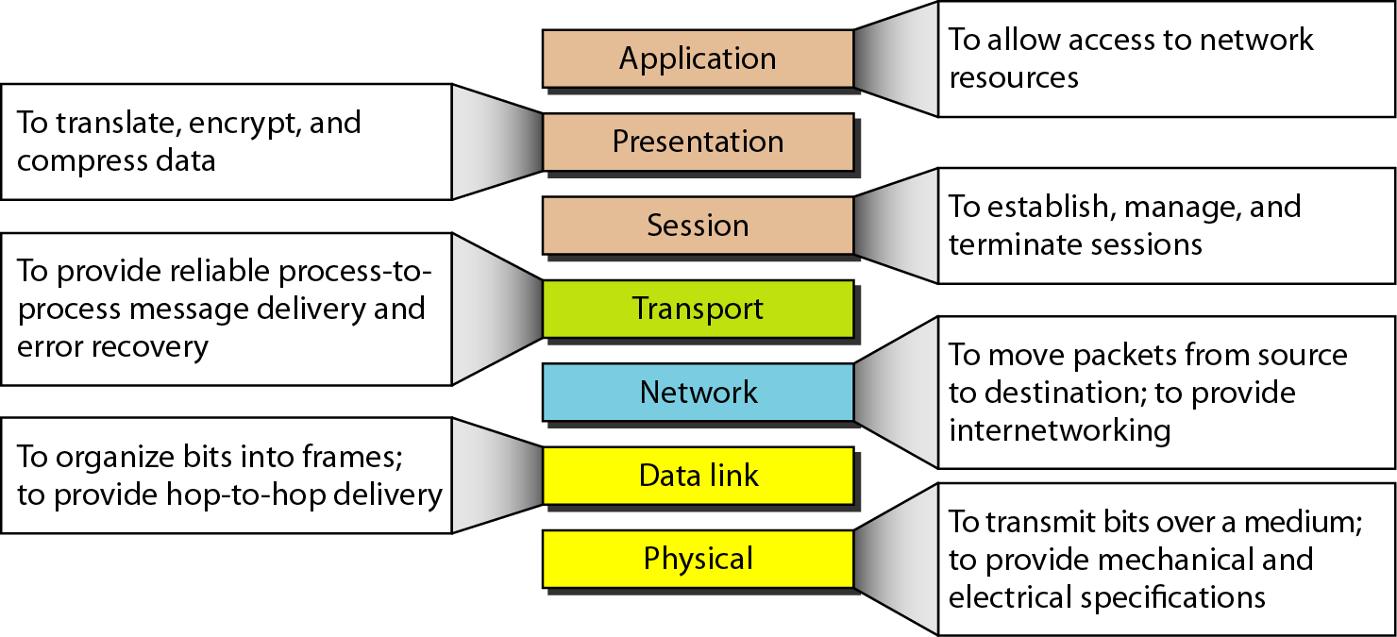
OSI Layers

Slide 7
Application Layer
The application layer is responsible for providing services to the user
It is at this point that the data is in a visual form a user can truly understand, rather than binary zeroes and ones
Does not include applications, rather only protocols that support the applications
Deals with properly processing and formatting the data before it moves to the layer below
This layer interfaces with the operating system and other applications and communicates data between files, messages, and other network activities.
Handles file transfer, virtual terminals, network management, and fulfilling network requests of applications.
Examples are: telnet, FTP, Web Browsers, Email, DNS

Slide 8
Presentation Layer
Responsible for defining how information is presented to the user in the interface (application layer) that they are using.
This layer provides a common means of representing data
It is not concerned with the meaning of the data but with the syntax and format of the data
Functions
Protocol conversion
Data translation
Compression
Encryption
Character set conversion
No protocols work in this layer
Example: ASCII, BMP, GIF, JPEG, WAV, AVI, and MPEG

Slide 9
Session Layer
The session layer is responsible for establishing, maintaining, synchronizing and terminating connections between two applications
Session layer provides mechanism for controlling the dialogue between the two end systems – Dialogue Management
This layer requests for a logical connection to be established on an end-user’s request
This layer provides services like dialogue discipline which can be full duplex, half duplex or simplex
This layer provides interprocess communication channels
Protocols that work at this layer
PAP, PPTP, NetBIOS, RPC
They are the least used protocols in network environments
Dangerous to have these protocols exposed to external networks

Slide 10
Transport Layer
Provides end-to-end data transport services and establishes the logical connection between two computers
Ensures that the data units are delivered error free.
Ensures that data units are delivered in sequence.
Ensures that there is no loss or duplication of data units.
Provides connectionless or connection oriented service.
Provides for the connection management.
Protocols at this layer: TCP,UDP, AH, SPX

Slide 11
Network Layer
Implements routing of frames (packets) through the network.
Defines the most optimum path the packet should take from the source to the destination
Defines logical addressing so that any endpoint can be identified.
Handles congestion in the network.
The network layer also defines how to fragment a packet into smaller packets to accommodate different media
Protocols that work at this layer: IP, ICMP, OSPF, RIP, IGMP

Slide 12
Data Link Layer
Organizes data bits into frames
The data link layer defines hardware (physical or MAC) addresses as well as the communication process that occurs within a media type.
LLC is responsible for handling multiple Layer3 protocols and link services like reliability flow control and error control
MAC is responsible for framing and media access control for broadcast media
Protocols that work at this layer: PPP, ATM, Ethernet, FDDI, L2TP

Slide 13
Physical Layer
Provides physical interface for transmission of information
Defines rules by which bits are passed from one system to another on a physical communication medium
Type of signaling such as analog or digital
Electrical or optical characteristics of signal
Asynchronous, synchronous, simplex, full or half duplex
Data rate such as 10, 100, or gigabit
Topology such as star, bus, ring
ISDN, DSL, SONET are some of the standard interfaces at this layer

Slide 14
Multilayer Protocols
Distributed Network Protocol 3
Communications protocol specifically used for SCADA Systems
Does not incorporate routing functionality
Controller Area Network Bus
Protocol designed to allow microcontrollers and other embedded devices to communicate each other on a shared bus
Robust in noisy environments
All devices on the network receive every bit of information sent on the BUS
Cost Effective

Slide 15
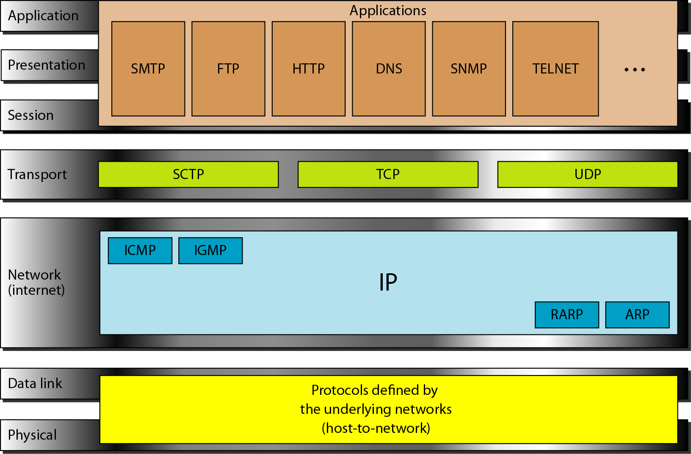
TCP/IP Model

Slide 16
TCP
Connection oriented
Explicit set-up and tear-down of TCP session
Stream-of-bytes service
Sends and receives a stream of bytes, not messages
Reliable, in-order delivery
Checksums to detect corrupted data
Acknowledgments & retransmissions for reliable delivery
Sequence numbers to detect losses and reorder data
Flow control
Prevent overflow of the receiver’s buffer space
Congestion control
Adapt to network congestion for the greater good

Slide 17
Establishing a TCP Connection
A
B
SYN
SYN ACK
ACK
Data
Data
Three-way handshake to establish connection
Host A sends a SYN (open) to the host B
Host B returns a SYN acknowledgment (SYN ACK)
Host A sends an ACK to acknowledge the SYN ACK

Slide 18
 | TCP | UDP
Acronym for | Transmission Control Protocol | User Datagram Protocol or Universal Datagram Protocol
Connection | TCP is a connection-oriented protocol. | UDP is a connectionless protocol.
Usage | TCP is suited for applications that require high reliability, and transmission time is relatively less critical. | UDP is suitable for applications that need fast, efficient transmission, such as games. UDP's stateless nature is also useful for servers that answer small queries from huge numbers of clients.
Use by other protocols | HTTP, HTTPs, FTP, SMTP, Telnet | DNS, DHCP, TFTP, SNMP, RIP, VOIP.
Ordering of data packets | TCP rearranges data packets in the order specified. | UDP has no inherent order as all packets are independent of each other. If ordering is required, it has to be managed by the application layer.
Speed of transfer | The speed for TCP is slower than UDP. | UDP is faster because error recovery is not attempted. It is a "best effort" protocol.
Reliability | There is absolute guarantee that the data transferred remains intact and arrives in the same order in which it was sent. | There is no guarantee that the messages or packets sent would reach at all.
Header Size | TCP header size is 20 bytes | UDP Header size is 8 bytes.
Streaming of data | Data is read as a byte stream, no distinguishing indications are transmitted to signal message (segment) boundaries. | Packets are sent individually and are checked for integrity only if they arrive. Packets have definite boundaries which are honored upon receipt, meaning a read operation at the receiver socket will yield an entire message as it was originally sent.
Weight | TCP is heavy-weight. TCP requires three packets to set up a socket connection, before any user data can be sent. TCP handles reliability and congestion control. | UDP is lightweight. There is no ordering of messages, no tracking connections, etc. It is a small transport layer designed on top of IP.
Data Flow Control | TCP does Flow Control. TCP requires three packets to set up a socket connection, before any user data can be sent. TCP handles reliability and congestion control. | UDP does not have an option for flow control
Error Checking | TCP does error checking and error recovery. Erroneous packets are retransmitted from the source to the destination. | UDP does error checking but simply discards erroneous packets. Error recovery is not attempted.
Acknowledgement | Acknowledgement segments | No Acknowledgment
Handshake | SYN, SYN-ACK, ACK | No handshake (connectionless protocol)

Slide 19
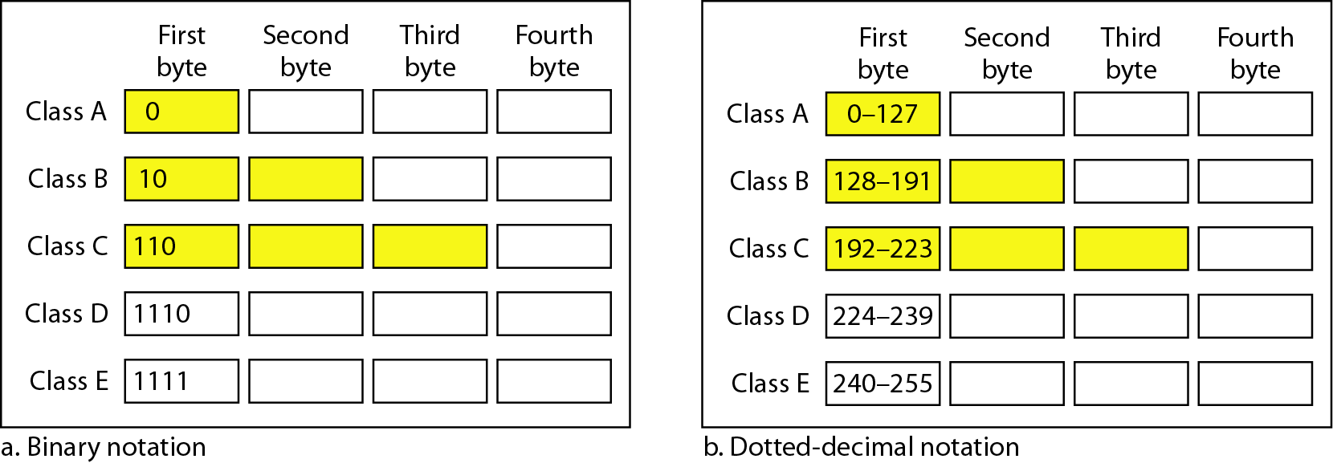
IPV4 Address
An IPv4 address is 32 bits long
Each address has a network portion and host portion
Addresses are grouped into classes and then into subnets
Provides addressing, packet fragmentation, timeouts, TTL, Type of Service capabilities
The process of dividing a network into smaller network sections is called subnetting

Slide 20
CIDR
Classless Inter Domain Routing provides flexibility to increase or decrease the class sizes as necessary
CIDR is also referred to as supernetting
It is a system of defining the network part of an IP address
It allows a way to break IP networks down more flexibly than their base class
CIDR was defined to allow variable length subnet masks (VLSM) to be applied to networks. The basic premise of VLSM is to provide the count of the number of network bits in a network.

Slide 21
IPV6
Increases the address space than currently by IPV4
IPv6 allows scoped addresses, end-to-end secure transmission and authentication
Has more flexibility and routing capabilities and allows for QoS
Allows auto configuration and auto tunneling
Routing infrastructure automatically determines the tunnel endpoints so that protocol tunneling takes place without pre-configuration

Slide 22
IPv6 | IPv4
IP address size 128 bit | IP address size 32 bit
Scalability of multi-cast routing is improved by adding a scope field to multicast address | No such option
Anycast address – used to send a packet to any one of a group of nodes | No such option
Extensions to support authentication, data integrity, data confidentiality | No support

Slide 23
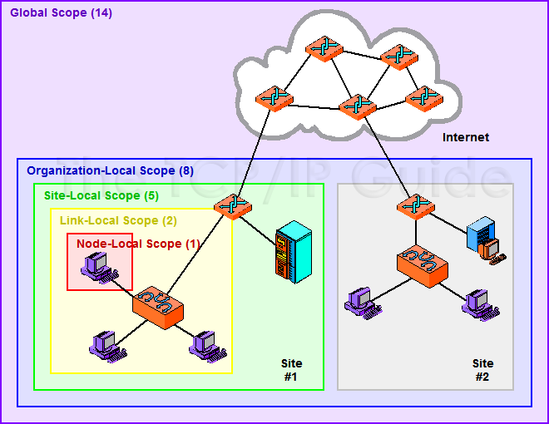
Scoped Address
The scope allows routers to immediately determine how broadly they should propagate multicast datagrams, to improve efficiency and eliminate problems with traffic being sent outside the area for which it is intended
http://www.tcpipguide.com/free/t_IPv6MulticastandAnycastAddressing-2.htm

Slide 24
Tunneling Methods
6to4 Tunneling Method
A system that allows IPv6 packets to be transmitted over an IPv4 network without the need to configure explicit tunnels.
6to4 is simply a transparent mechanism used as a transport layer between IPv6 nodes
6to4 does not facilitate interoperation between IPv4-only hosts and IPv6-only hosts
6to4 performs three functions:
Assigns a block of IPv6 address space to any host or network that has a global IPv4 address.
Encapsulates IPv6 packets inside IPv4 packets for transmission over an IPv4 network using 6in4.
Routes traffic between 6to4 and "native" IPv6 networks.

Slide 25
Teredo tunneling
Teredo is a built-in mechanism in Windows systems that is used to give a single system behind an IPv4 NAT access to IPv6
Uses UDP encapsulation
It is not very reliable, but Teredo is only used when explicitly connecting to an IPv6 address
Like 6to4 it uses public relays

Slide 26
ISATAP
managed technology for providing IPv6 on an IPv4 network
It emulates IPv6 connectivity on the IPv4 infrastructure.
Treats the IPv4 network as virtual IPv6 local links, with mappings from each IPv4 address to a link-local IPv6 address
ISATAP is an intrasite mechanism
Used for connectivity within a same network

Slide 27
Layer 2 Security Standards
IEEE MAC Security Standard – 802.1AE
Defines security infrastructure to provide data confidentiality, data integrity, and data origin authentication.
MACsec provides hop-by-hop protection at layer 2
Integrates security protection into wired Ethernet networks
IEEE 802.1AR Standard
Specifies unique per device identifier and management/cryptographic binding of a device to its identifier
Allows trustworthiness of devices and facilities secure device provisioning
These unique hardware based credential identifiers can be used in EAP-TLS
IEEE 802.1AF – Carries out key agreement functions for the session keys used for data encryption.

Slide 28
Converged protocols
Fiber channel over Ethernet (FCoE)
Protocol encapsulation that allows Fiber channel frames to ride over Ethernet networks
Currently used in some SAN environments, otherwise not commonly used
Multiprotocol labeling Switching (MPLS)
It has elements of both layer 2 and layer 3
It can encapsulate any higher level protocol and tunnel it over a variety of links
iSCSI
Encapsulates SCSI data in TCP segment
This gives the ability of the peripheral device to appear as local though they may be not physically closer to the local computer.

Slide 29
Transmission Types
Analog | Digital
Data is represented in Wave values | Data is represented in discrete voltage values
Not reliable over long distance due to distortion | More reliable over long distance
Difficult to extract analog signals from background noise | Provides efficient and clear cut signaling method
Could have infinite number of values or states | Is a Square wave that exists in discrete states
 | Can implement data compression to increase data throughput; provide signal integrity through repeaters and multiplex different type of data onto same transmission channel

Slide 30
Asynchronous | Synchronous
Start and stop bits are used for communication | Synchronization happens over timing sequence, which is initiated by a clock pulse
ATM protocol uses start stop bits | Data link protocol HDLC uses clock pulse
Transfers as frames per start and stop bit | Transfer data in a stream of bits
Parity bit used for error control | Robust error-checking, CRC
Each byte requires 3 bits of transmission (start, stop, parity) | Minimal overhead compared to Asynchronous
Environments that send data in a non-predictable manner have protocols that use asynchronous timing mechanisms | Used for high-speed high-volume transactions

Slide 31
Broadband | Baseband
Divides the communication channel into independent sub-channel | Uses the entire communication channel for transmission
Carriers different signals over different sub channel | Permits only one signal to transmit at a time
Bandwidth:
Number of electrical pulses that can be carried over a link within a second
Data transfer capability of a connection
Commonly associated with the amount of available frequencies and speed of a link
Data throughput:
Actual amount of data that can be carried over the connection
Data throughput values can be higher than bandwidth if compression is used.

Slide 32
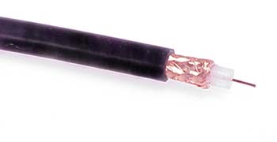
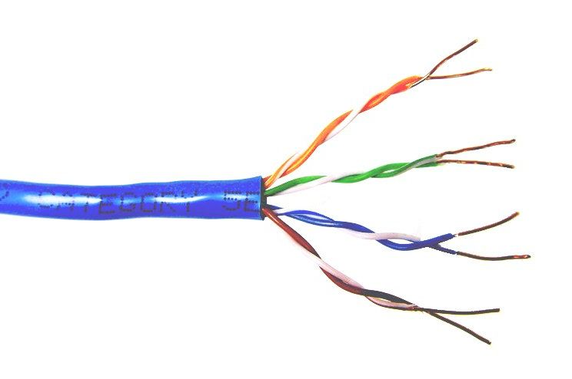
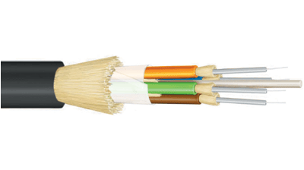
Common network cable types
Coaxial cable
Unshielded twisted pair
Fiber optic

Slide 33
Why copper?
Copper has several important properties which make it well suited for electronic cabling:
Conductivity — Copper is an excellent conductor of electric current and heat.
Corrosion Resistance — Copper will not rust and is fairly resistant to corrosion.
Ductility — Copper possesses the ability to be drawn into thin wires without breaking.
Malleability — Pure copper is easy to shape.
Strength — Copper keeps its strength and toughness up to about 400 °F.

Slide 34
Copper Cable Components
Regardless of the construction, most cables contain certain common elements. These are:
A sheath or jacket for protection.
Insulation to prevent short circuits between the individual conductors.
Spacers to preserve the electrical properties of the cable.
Notes:
A copper wire in a cable can be composed of a single solid copper core or a bundle of thin strands. There are advantages and disadvantages of each

Slide 35
Cable Insulation
Insulation is a high resistance material that is coated on the conductor to resist the flow of current between conductors in the cable. There are three primary categories of insulators:
Thermoplastics - Polyvinylchloride (PVC), Polyethylene, Polypropylene. These are widely used and resist most sunlight, ozone, oil, and solvents.
Fluoropolymers - Teflon. These are used for high temperature applications. Used in Plenum areas.
Elastomers - These are rubber like and return to shape after tension is released.

Slide 36
Plenum
Cable type codes are important because cables often run in ventilation system return spaces above ceilings or below floors.
Such spaces, called plenums, must not quickly fill with toxic gasses should a small fire break out because the air conditioning system will spread the poisonous fumes to other areas of the building.
Plenum-rated cables have jackets made of materials that are slow burning and do not emit toxious fumes.

Slide 37
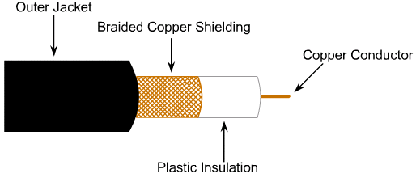
Coaxial Copper Cable
Coaxial cable consists of a copper center conductor, either stranded or solid, which is wrapped in insulation and covered with one or more layers of braid and foil.
More resistant to EMI, provides higher bandwidth, supports longer cable length than twisted pairs
Used as transmission line for Radio frequency signals

Slide 38
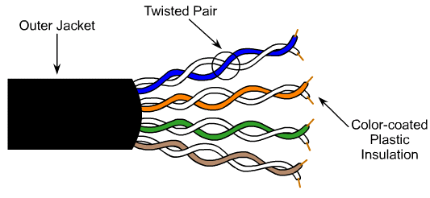
Twisted Pair Copper Cable
Twisted-pair cabling consists of pairs of insulated copper wires that are twisted together and then housed in a protective sheath.
The twisting of each pair of wires provides a cancellation effect that helps neutralize noise and null out interference.
The tighter the twisting, the more resistant the cable is to interference and attenuation
The result is that in twisted-pairs, interference such as EMI and RFI tends to be canceled out.

Slide 39
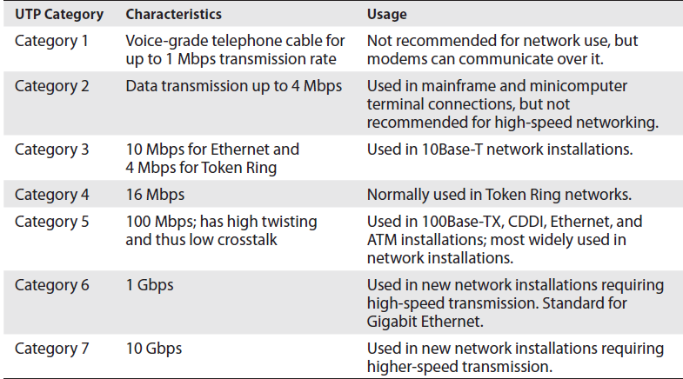

Slide 40
Unshielded Twisted-Pair (UTP) Cable / STP
This type of cable relies solely on the cancellation effect, produced by the twisted wire pairs, to limit signal degradation caused by EMI (Electromagnetic Interference) and RFI (Radio Frequency Interference).
UTP cable is used in a variety of networks. It can come with many different numbers of pairs inside the jacket.
It is the least secure networking cable compared to coaxial and fiber
STP is more expensive than UTP due to the extra shielding.
STP is less flexible than UTP because of the shielding and is more difficult to install.
Notes:
UTP cable must follow precise specifications as to how many twists are permitted. More twists result in fewer problems with signal degradation, but it can be costly
Installers must take care not to be deceived by the simplicity of UTP. The strength of the cable in each installation can be measured by the attention to detail during installation
In situations where the cable is bent, even tight twisting does not prevent the pairs from separating or from bunching together. This can lead to degraded performance.

Slide 41
Fiber-optic cable
Carries data over glass as light waves
The glass core is surrounded by protective casing which is enclosed inside an outer jacket
It has higher transmission speeds that allow signals to travel over longer distance
It is much more secure than UTP/Coaxial
Single mode:
Small glass core; can transfer data over long distance; less susceptible to attenuation
Multimode:
Large glass core; can transfer more data, but only to shorter distance

Slide 42
Cabling Problems
Noise
Caused by surrounding devices or characteristics of the wiring
Eg: motors; computers, fluorescent light, microwave oven
Attenuation
Loss of signal strength as it travels
Attenuation increases with higher frequencies
Can also be caused by cable breaks and malfunctions
Cross talk
Occurs when electrical signals spill over the wires
UTP is more vulnerable than STP

Slide 43

Karthikeyan Dhayalan
MD & Chief Security Partner
www.cyintegriti.com

